Slide 1
EE 046746 - Technion - Computer Vision
Tutorial 12 - Attention and Transformers
Credit to Hila Manor

Slide 2
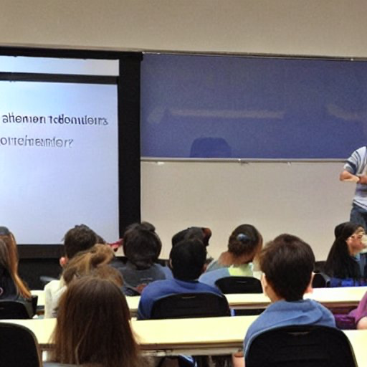
Prompt: university students learning about transformers and attention, you can clearly see a self-attention title in the slides

Slide 3

Agenda
Processing Sequences
Attention
Self-Attention
Who are Q, K, V?
Multiple Heads
The Transformer
Architecture Breakdown
A Zoo of Transformers
Recommended Videos
Credits

Slide 4

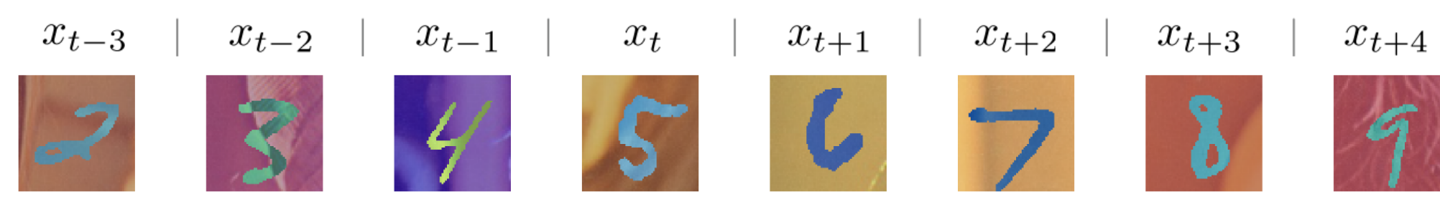
Processing Sequences
Many domains have data that is sequential in nature.
Natural language processing (NLP), speech and audio processing, financial data (such as stock prices), etc.
In sequential data, each data point depends on the ones that come before it.
So, we want context.
A 5 that came after a 4, which came after a 3, and so on...
But how long should our context be?

Slide 5
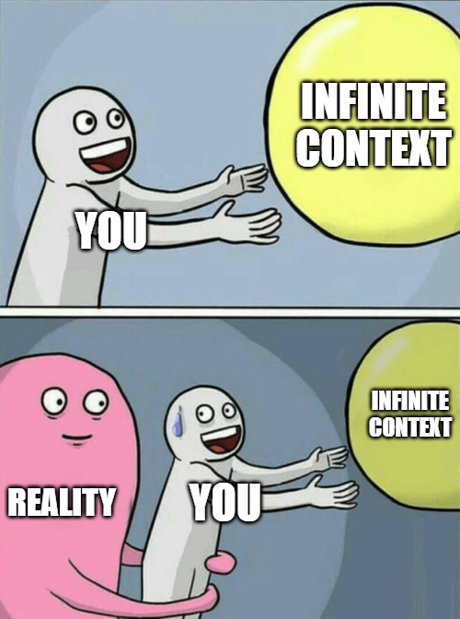
Not really possible…

Slide 6
Do we need “forever”?
Spoiler – Not really, we can do with “very long” too

Slide 7
Short Pivot to RNN’s
RNNs(Recurrent Neural Networks) are neural networks that process sequential data, capturing temporal dependencies.
RNNs update their hidden state based on current input and previous state, analyzing sequences of arbitrary lengths.
RNNs retain information from earlier inputs, making them useful for language modeling, speech recognition, and more.

Slide 8
Short Pivot to RNN’s
They are not very good though…
Vanishing gradients
Slow to train
Essentailly hold very short contexts

Slide 9
Now onto Attention
Presented first in the (extremly important paper) “Attention is all you need”, Vaswani et al.
Essentially, it wants to teach a model to pay attention to the more important features and understand the relationships between them.
An example:
Task: Translate the English sentence "I am a student" to French.
Let's assume we have a dictionary where each English word (a key) has a direct translation to French (a value)

Slide 10
Now onto Attention
Keys | Values
Student | étudiant
i | je
… | …
painting | tableau
How would you translate “I am a student”?

Slide 11
Now onto Attention
Will every key have a unique translation?
The correct translation is "Je suis étudiant". Only 3 words!
What is the role of the word "a" in this context?
Maybe the translation depends on more than just one word?
I am a female student -> Je suis étudiante

Slide 12
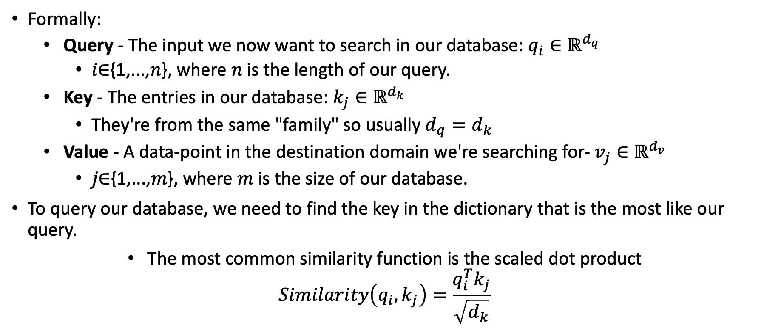
Attention
Formally:
Query - The input we now want to search in our database: $q_{i}∈ℝ^{d_{q}}$
𝑖∈{1,...,𝑛}, where 𝑛 is the length of our query.
Key - The entries in our database: $k_{j}∈ℝ^{d_{k}}$
They're from the same "family" so usually $d_{q}=d_{k}$
Value - A data-point in the destination domain we're searching for- $v_{j}∈ℝ^{d_{v}}$
𝑗∈{1,...,𝑚}, where 𝑚 is the size of our database.
To query our database, we need to find the key in the dictionary that is the most like our query.
The most common similarity function is the scaled dot product
$$Similarity\left(q_{i},k_{j}\right)=\frac{q_{i}^{T}k_{j}}{\sqrt{d_{k}}}$$

Slide 13
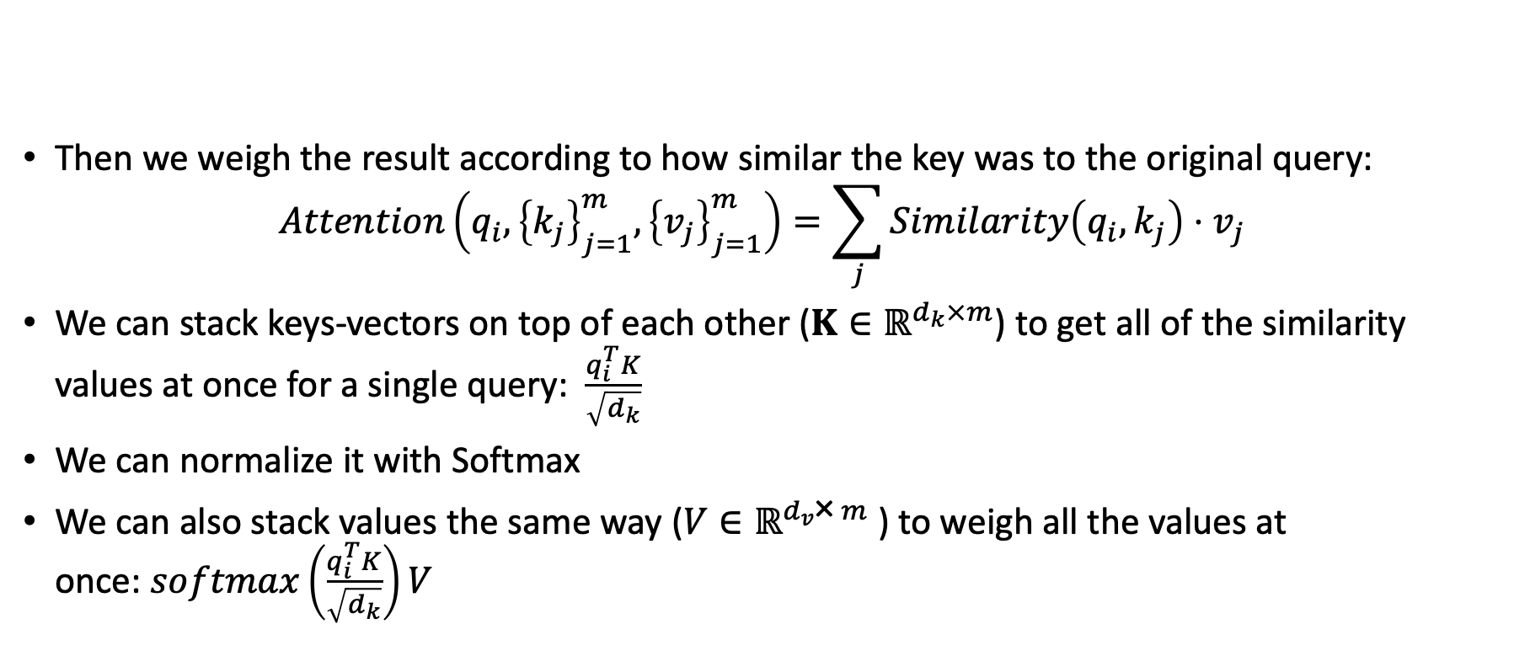
Attention
Then we weigh the result according to how similar the key was to the original query:
$$Attention\left(q_{i},{\left\{k_{j}\right\}}_{j=1}^{m},{\left\{v_{j}\right\}}_{j=1}^{m}\right)=\sum_{j}{Similarity\left(q_{i},k_{j}\right)⋅v_{j}}$$
We can stack keys-vectors on top of each other ($K∈ℝ^{d_{k}×m}$) to get all of the similarity values at once for a single query: $\frac{q_{i}^{T}K}{\sqrt{d_{k}}}$
We can normalize it with Softmax
We can also stack values the same way ($V∈ℝ^{d_{v}\text{×} m}$) to weigh all the values at once: $softmax\left(\frac{q_{i}^{T}K}{\sqrt{d_{k}}}\right)V$

Slide 14


Attention
And of course, we can also, stack the queries ($Q∈ℝ^{d_{q}\text{×}n}$)
$Attention\left(Q,K,V\right)$= $softmax\left(\frac{Q^{T}K}{\sqrt{d_{k}}}\right)V$

Slide 15
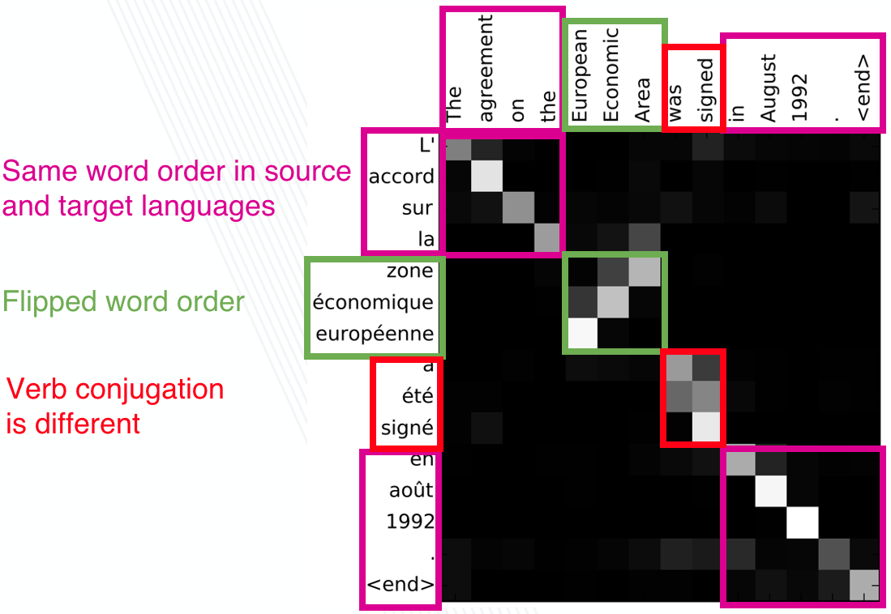
Attention Weights Matrix Visualization

Slide 16
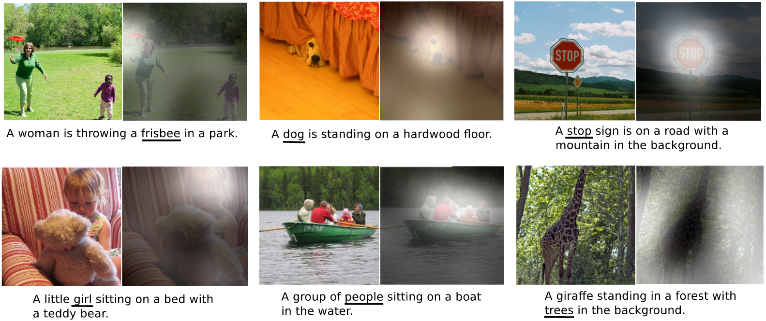
Attention Weights Matrix Visualization

Slide 17

Self-Attention
What if we want to find relationships between elements in the same input?
In self-attention we only have one domain.
So, we use the same "query" input for the keys as well
We query it against itself.
And the destination domain also uses the same input (from English to English, to English again).

Slide 18
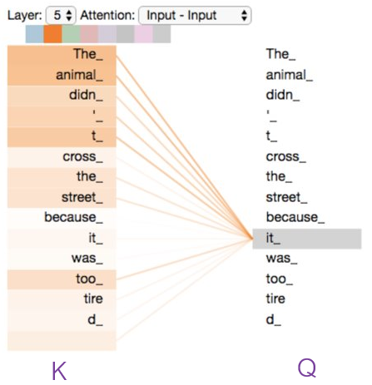
Self-Attention

Slide 19

Who are Q, K, V?
How did we get from a word to these vectors?
How do we get from an image to these vectors?
Cut the image to 16x16 patches, and embed each patch using an linear projection head (MLP).
Add some form of positional encoding, so we will have some sense of "where" each patch was.

Slide 20

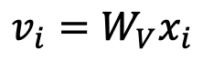
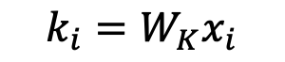
Who are Q, K, V?
Now to create Q,K,V, we multiply the embedded input $x_{i}∈ℝ^{d_{emb}}$ by Learnable matrices:
$W_{Q}∈ℝ^{d_{q}\text{×}d_{emb}}, W_{V}∈ℝ^{d_{v}\text{×}d_{emb}}, W_{K}∈ℝ^{d_{k}\text{×}d_{emb}}$
Remember, in self attention, all of the inputs are the same!
$$q_{i}=W_{Q}x_{i}$$
$$k_{i}=W_{K}x_{i}$$
$$v_{i}=W_{V}x_{i}$$

Slide 21
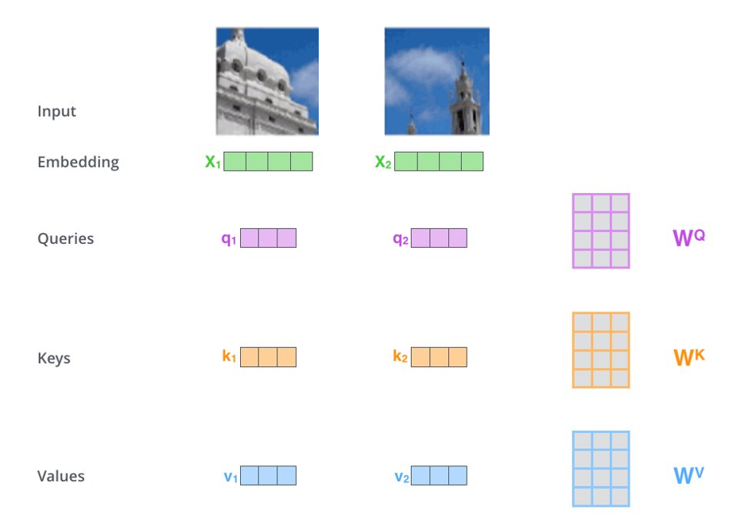
Who are Q, K, V?

Slide 22

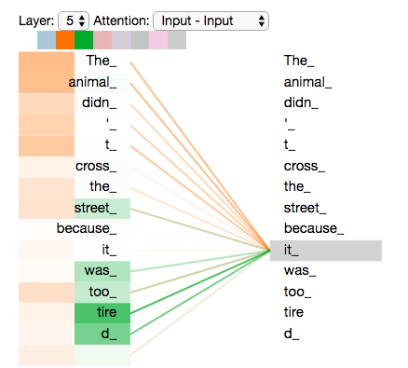
Multiple Heads
Can we pay attention to different stuff for the same input?

Slide 23
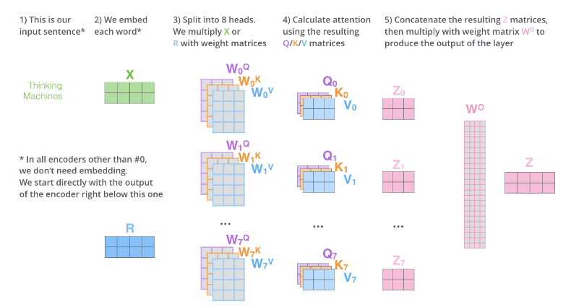

Multiple Heads
Learn multiple $W_{Q}, W_{K},W_{V}$ matrices, and combine the results from the different "heads".

Slide 24

The Transformer
The attention scheme received a lot of attention thanks to the paper Attention Is All You Need (76320 citations!!).
Before it, sequential data was processed... Sequentially.
Can't maximize the utilisation of the GPU!
Using attention, the data can be processed all-at-once.
Using the parallelization capabilities of GPUs.
The transformer is composed of an Encoder and a Decoder.

Slide 25

Encoder-decoder architectures
A common type of architecture used in many tasks.
The encoder maps the input to some latent representation, usually of a low dimension.
In the context of our course - the encoder is some type of feature extractor
The decoder applies a different mapping, from the latent space to some other space (sometimes back to the input space).
This can be used to generate new data.

Slide 26
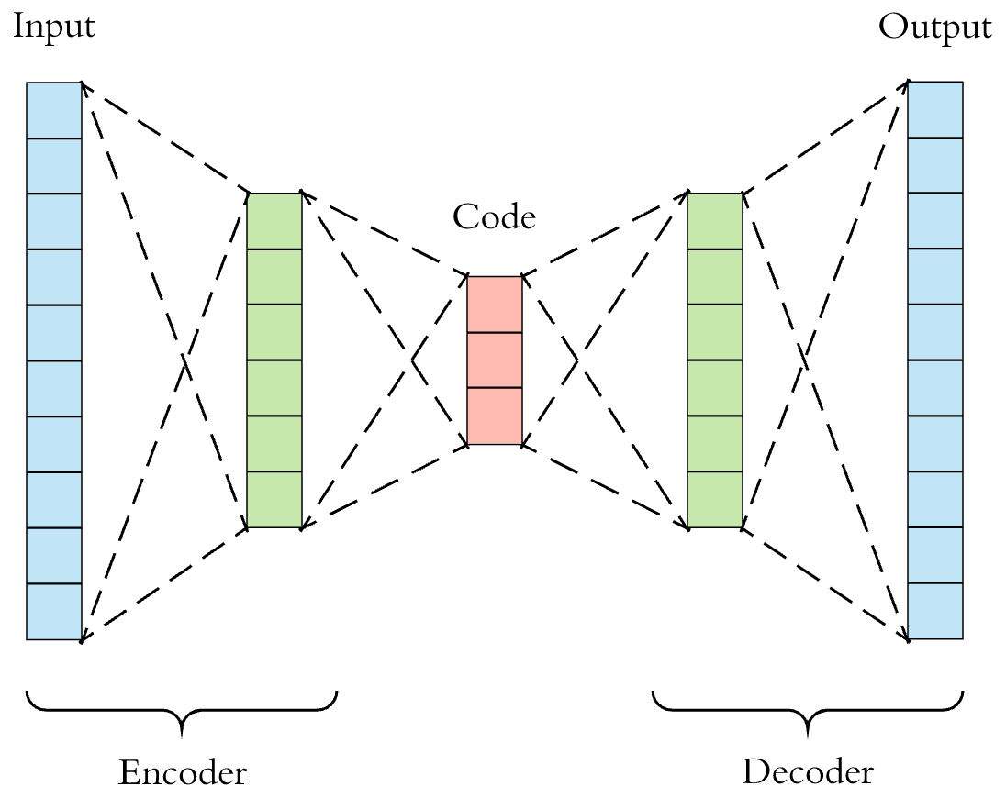
Encoder-decoder architectures

Slide 27

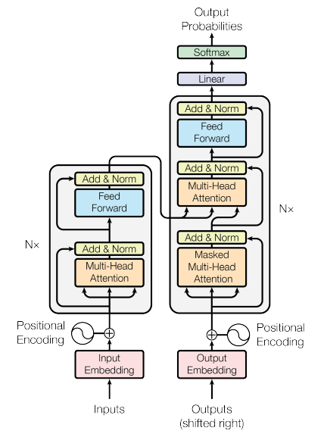
Scary Transformer Diagram

Slide 28

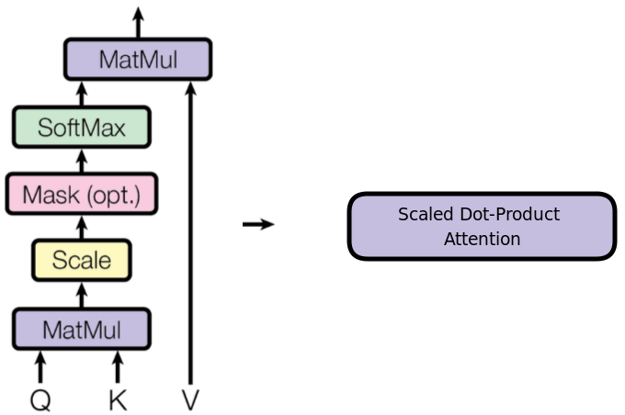
Breaking it down

Slide 29
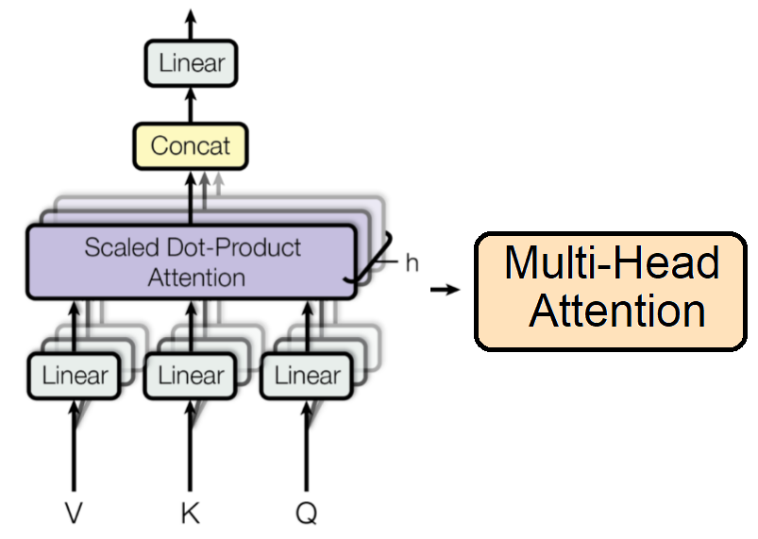
Breaking it down

Slide 30
Breaking it down

Slide 31
Breaking it down
In the transformer:
The encoder uses attention layers to create meaningful features.
The decoder uses the previous outputs to query which of those features is important for the next output (keys and values).

Slide 32
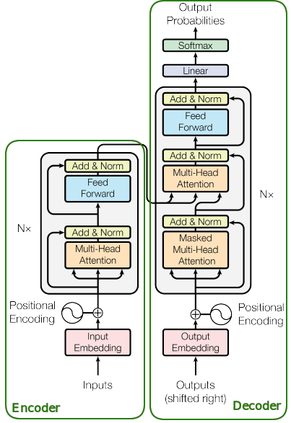
Breaking it down

Slide 33
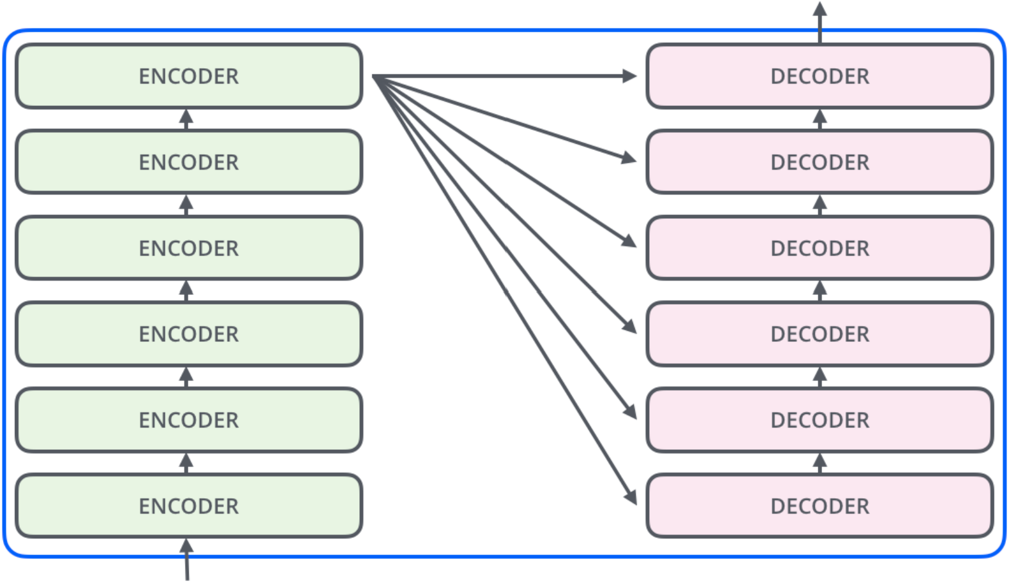
Breaking it down

Slide 34

A Zoo of Transformers
Since that paper, people have used the transformer architecture in many ways, for many different tasks.
We’ll focus on vision

Slide 35
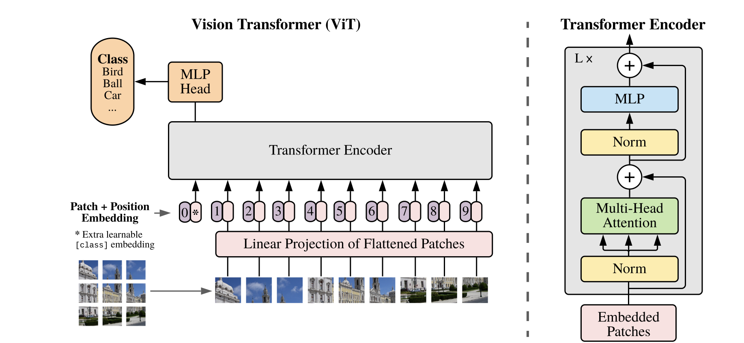
The Vision Transformer(ViT)

Slide 36
GPT

Slide 37
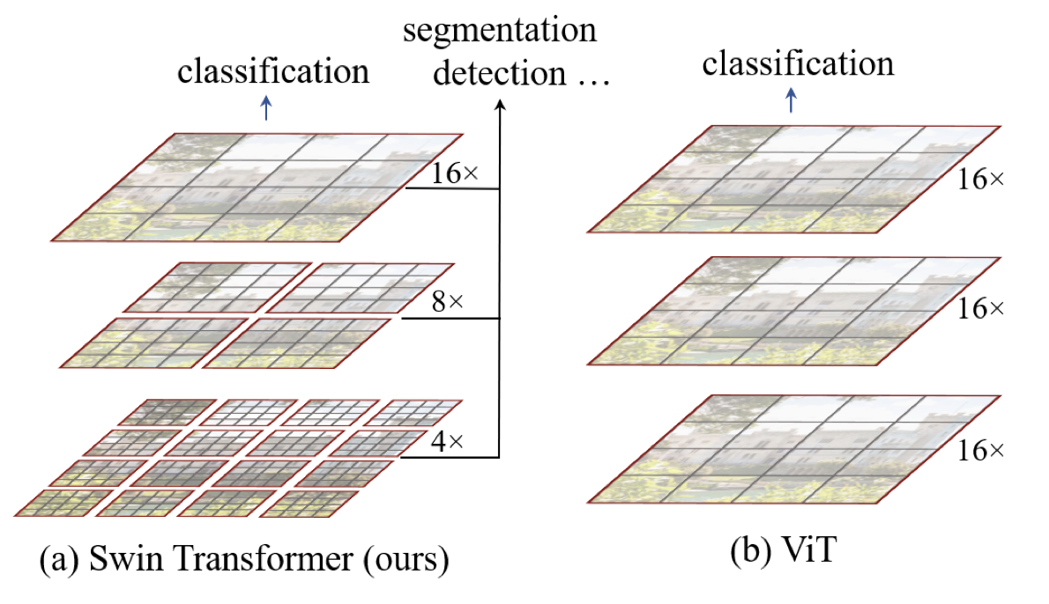
Swin Transformer
Notes:
The Swin Transformer revolutionizes computer vision with its enhanced performance, efficiency, and adaptability to diverse vision tasks, thanks to its unique hierarchical structure, shifted window self-attention, and relative positional encoding

Slide 38
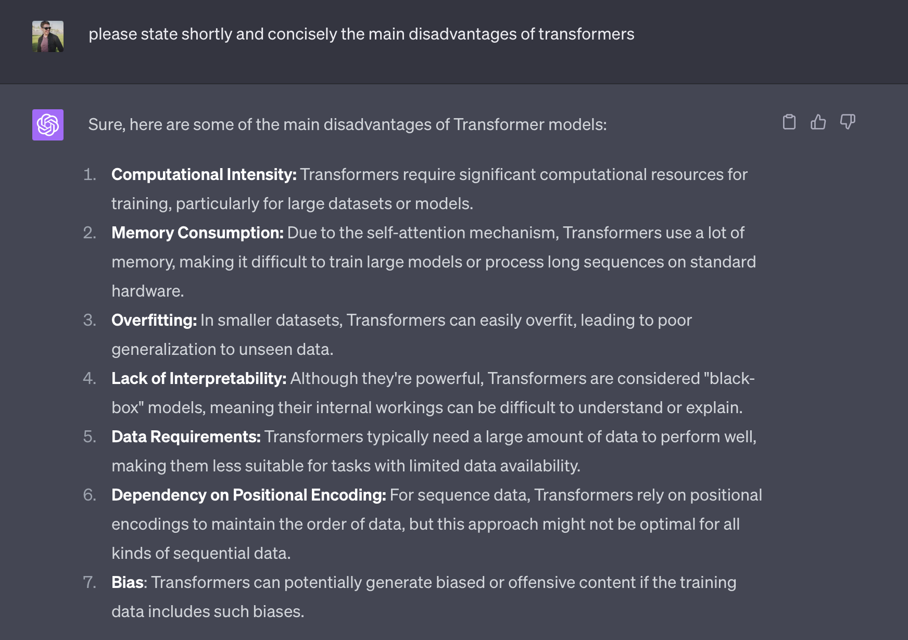
Why aren’t they everywhere?

Slide 39
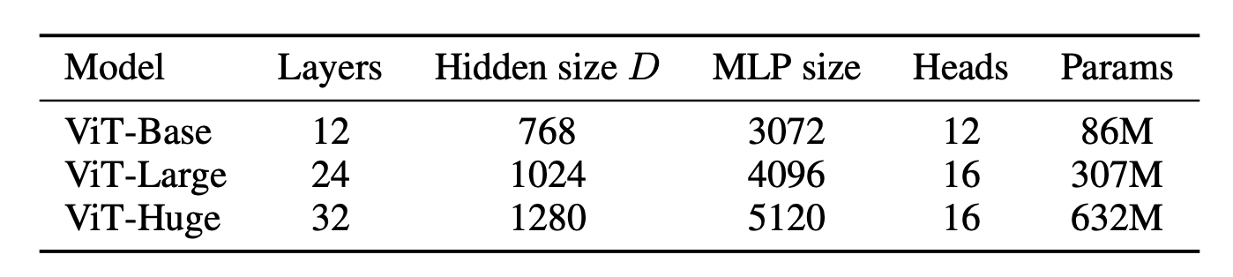
Why aren’t they everywhere?

Slide 40
Questions?

